Slide 1
BLOOD DONATION & PLASMA DONATION
P.Vanaja 19BQ1A05I5
M.Ajay Kumar 19BQ1A05E0
M.Akash 19BQ1A05D1
K.Shivaiah 20BQ5A0516
Under the guidance of MS. D. DEEPTHI mam

Slide 2
Agenda:
Abstract
Proposed Solution
Hardware and Software Requirements
Advantages

Slide 3
ABSTRACT:
Blood donation is required during an organ transplant, accidents, cancer treatment etc. For blood donation, one needs to check for a donation camp or needs to visit blood bank. The Manual Blood donation system has many disadvantages.
which includes, it is too time consuming, often leads to error prone results, consumes lot of manpower, lacks donor information, retrieval of data takes a lot of time, percentage of accuracy is less.

Slide 4
Proposed Solution:
This online blood and plasma donation management system maintains the list of blood donors and plasma donors.
This project aims at maintaining all information regarding blood donors and plasma donors of different blood groups and plasma available and also helps the recipients to track and search the right donor easily and help them better.

Slide 5
Hardware requirements:
Operating System: 32/64-Bit operating system, x86/x64-based processor.
Processor: 2.0 GHz processor speed.
Memory: 2GB RAM.
Software requirements:
Front-end :- HTML5, CSS and JavaScript.
Back-end :- PHP
Database Server: MySQL/XAMPP.

Slide 6
Advantages:
The system makes the overall project management much easier and flexible.
It provides high level of security with different level of authentication.
Time consumption is very less.
Customer won’t have to wait for long time for website browsing.

Slide 7
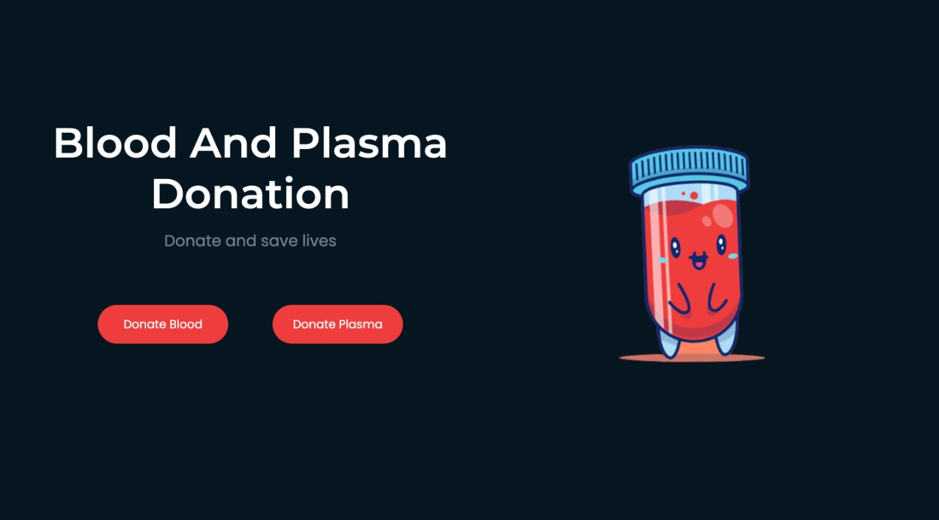

Slide 8
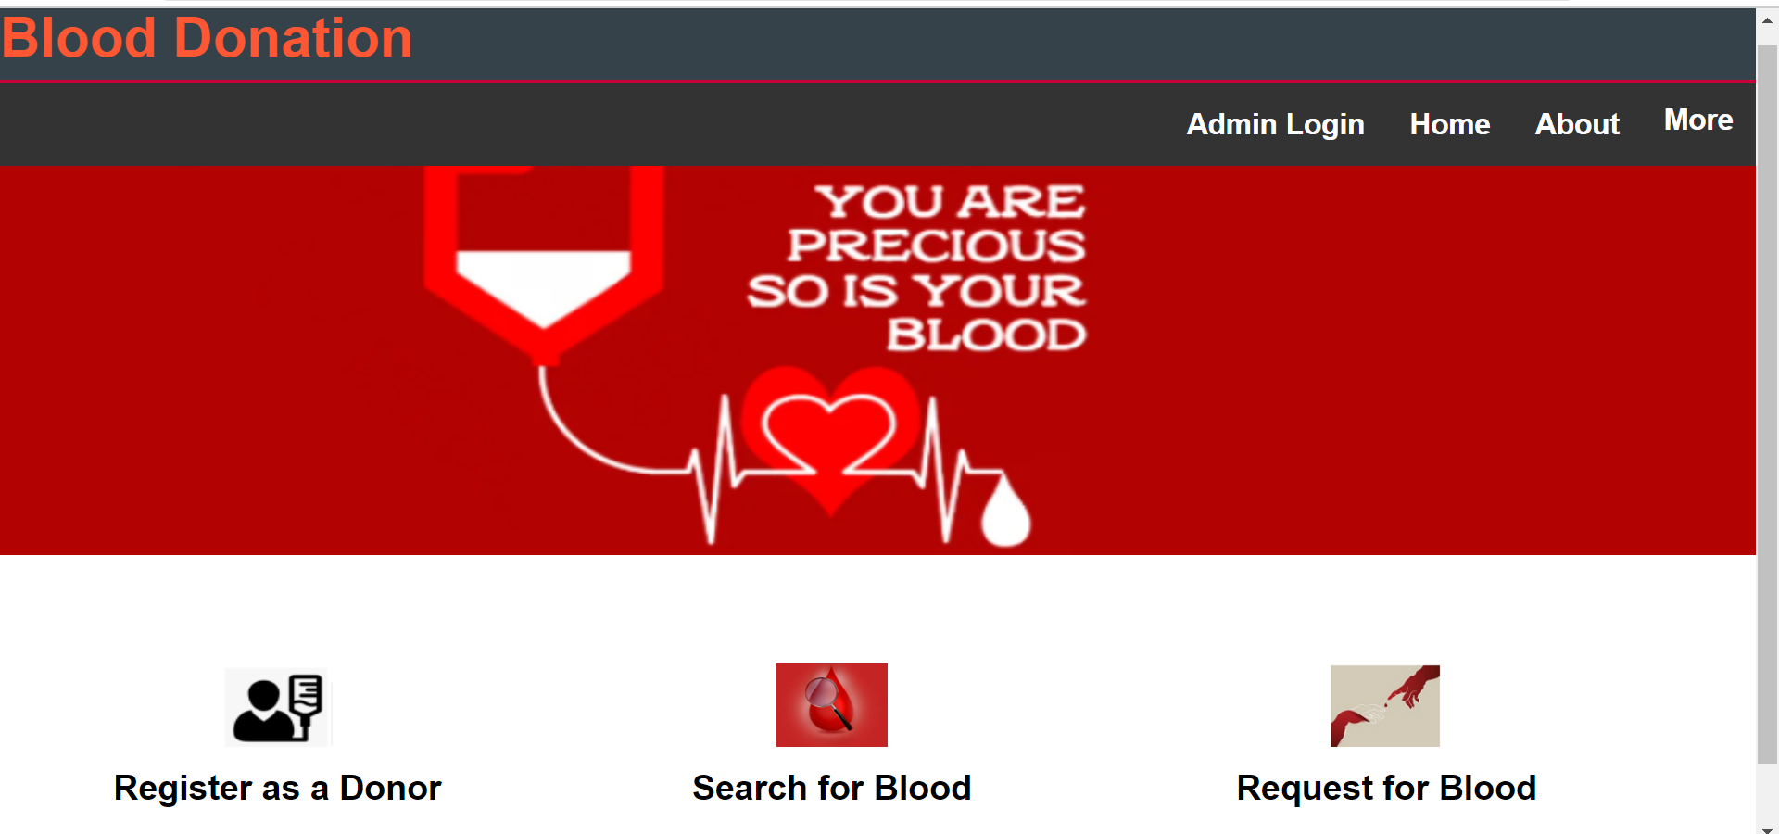

Slide 9
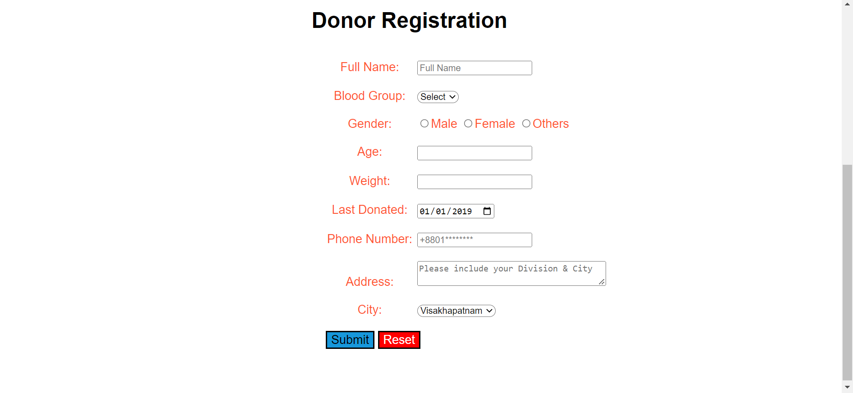

Slide 10
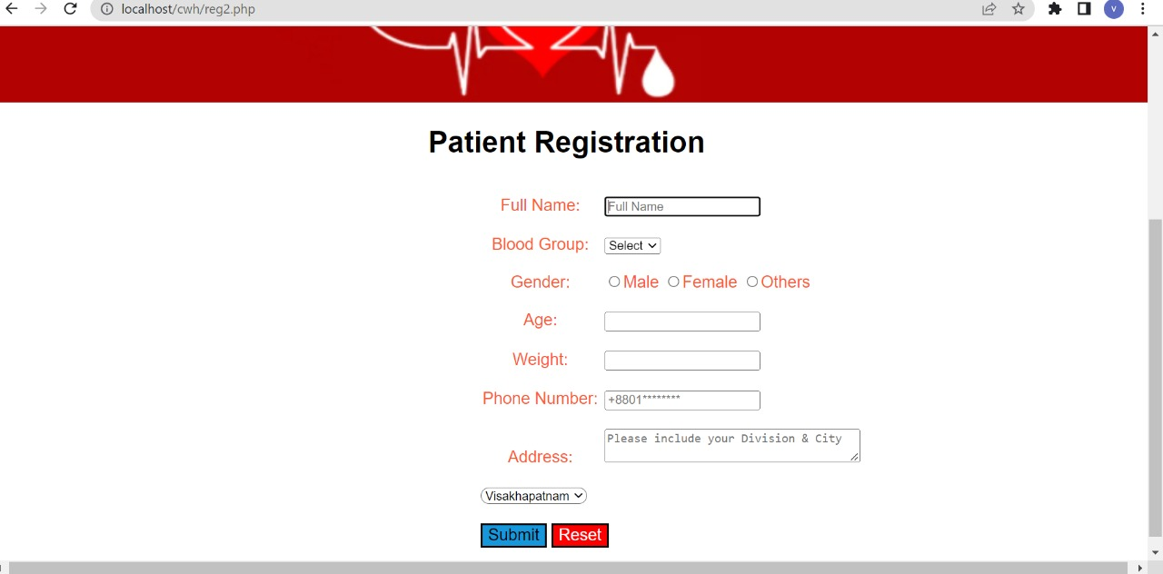

Slide 11
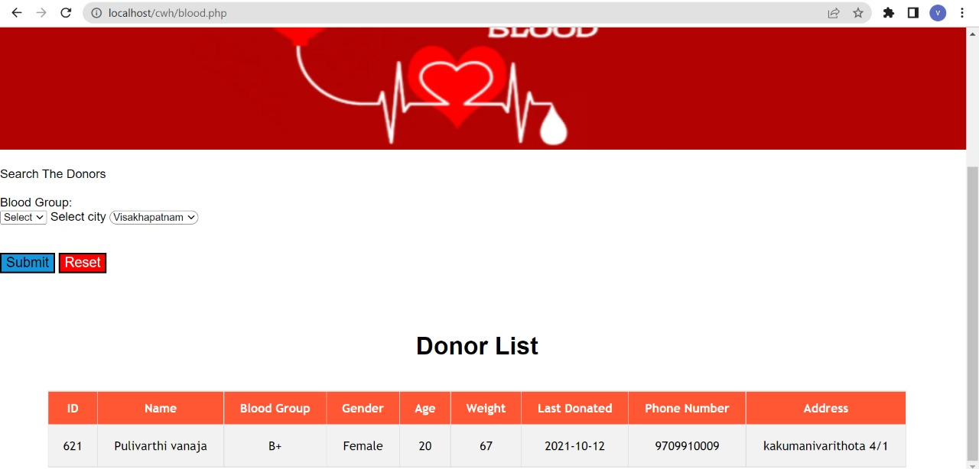

Slide 12
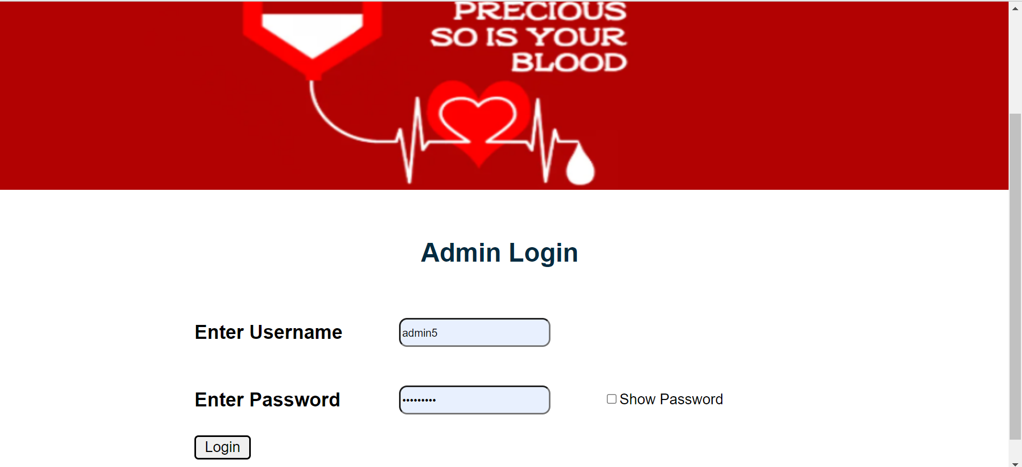

Slide 13
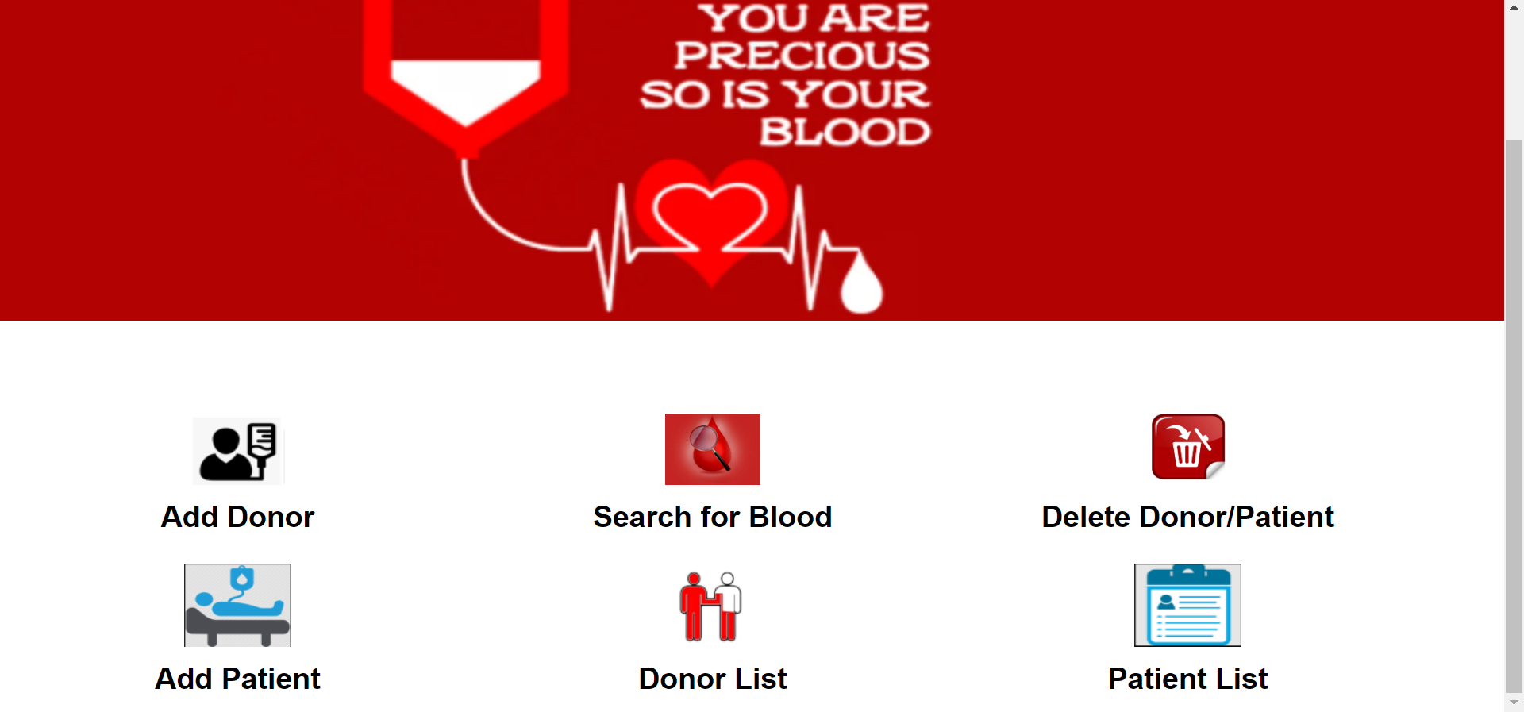

Slide 14
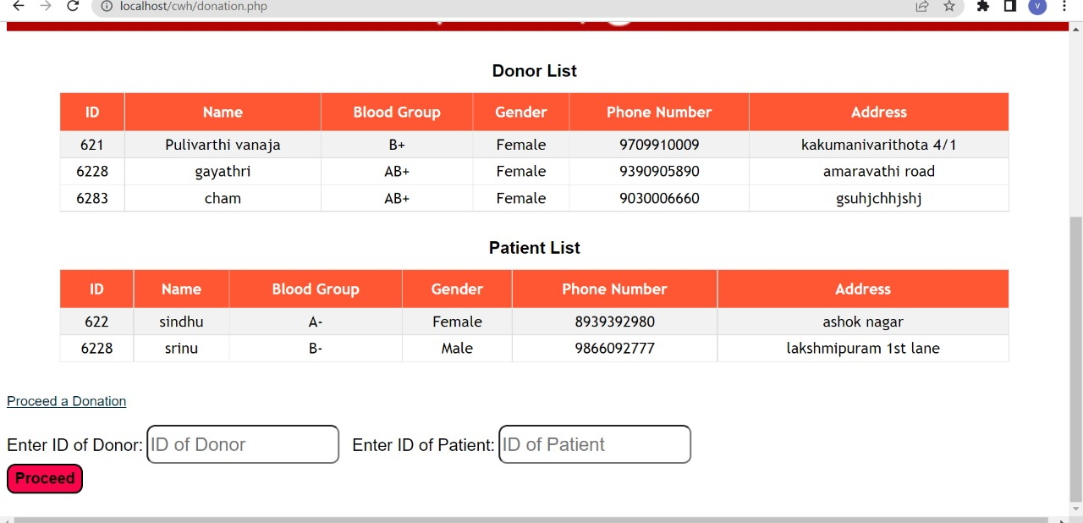

Slide 15
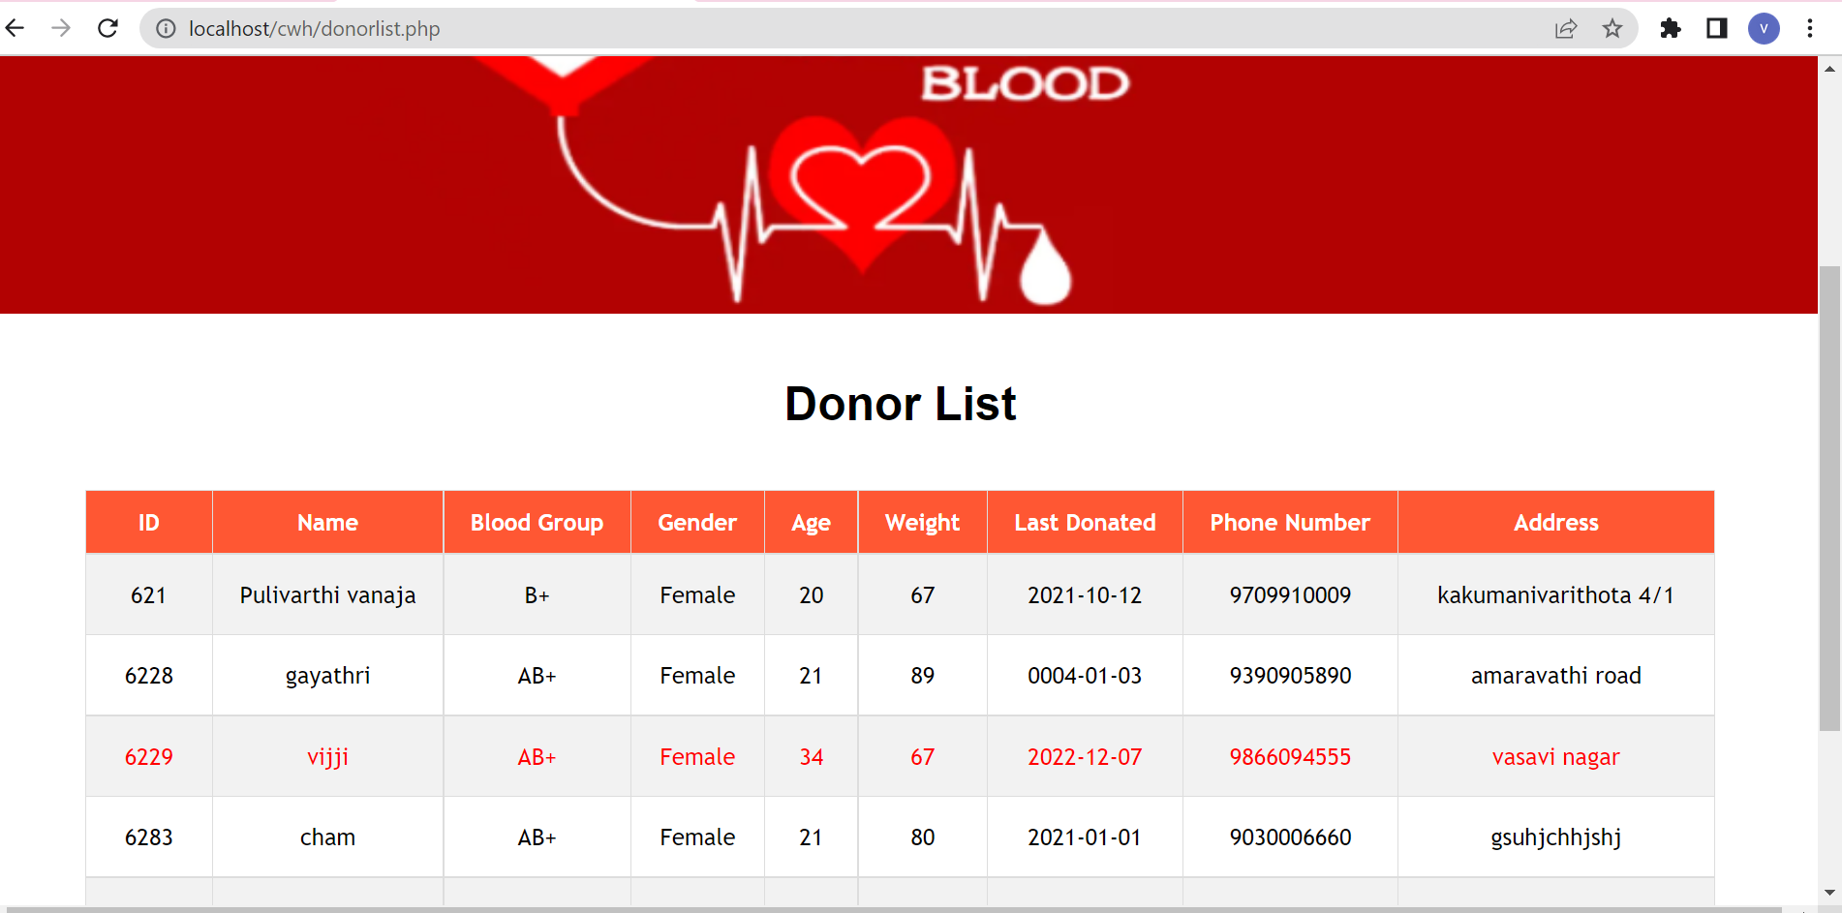

Slide 16
Plasma Donation
If a person is fully recovered from COVID-19 his/her plasma now contains COVID-19 antibodies. These antibodies provided one way for the immune system to fight the virus when they were sick, so the plasma may be able to be used to help others fight off the disease.

Slide 17
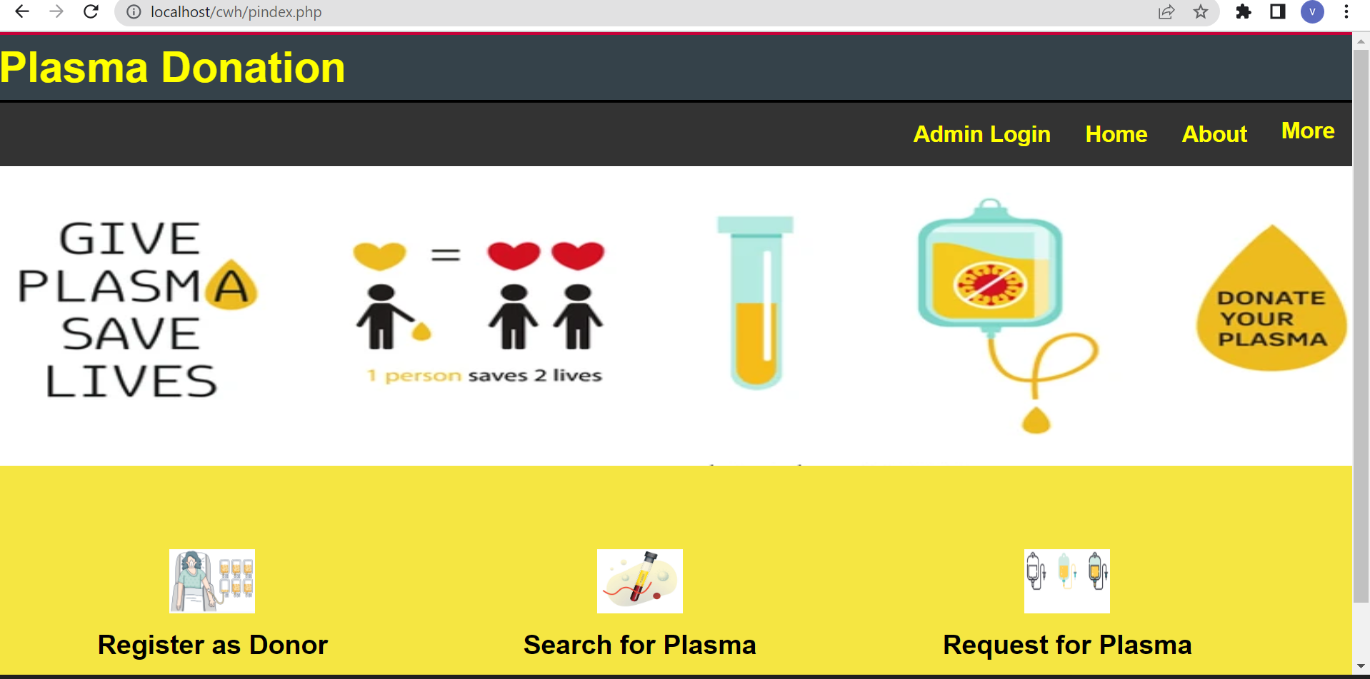

Slide 18
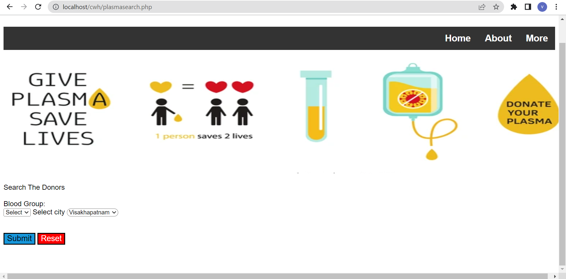

Slide 19
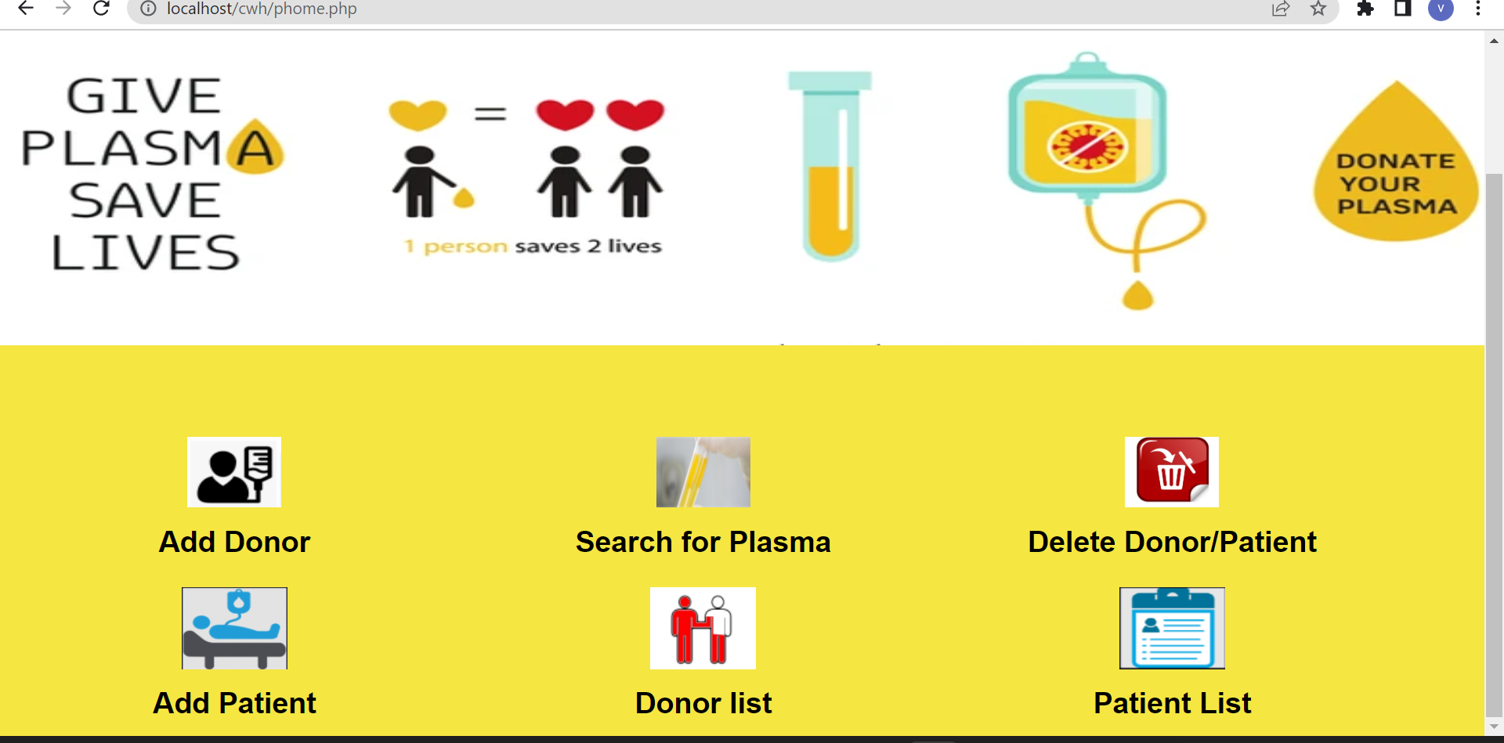

Slide 20
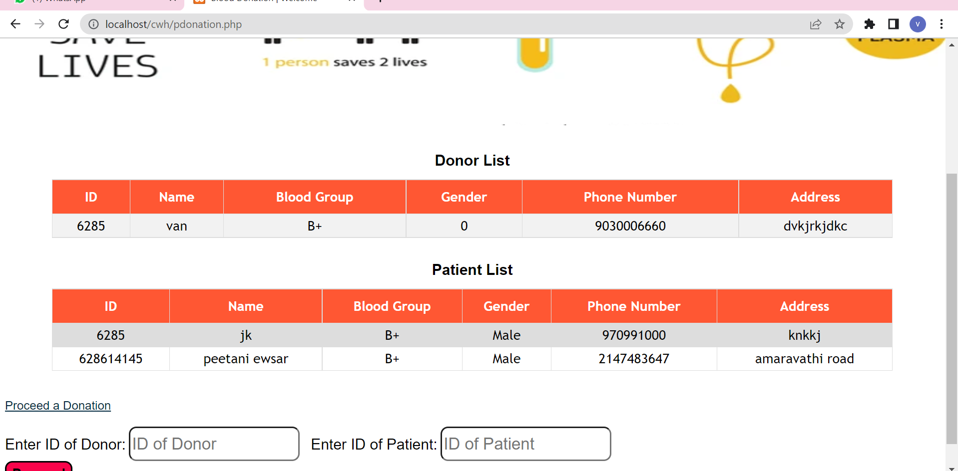

Slide 21
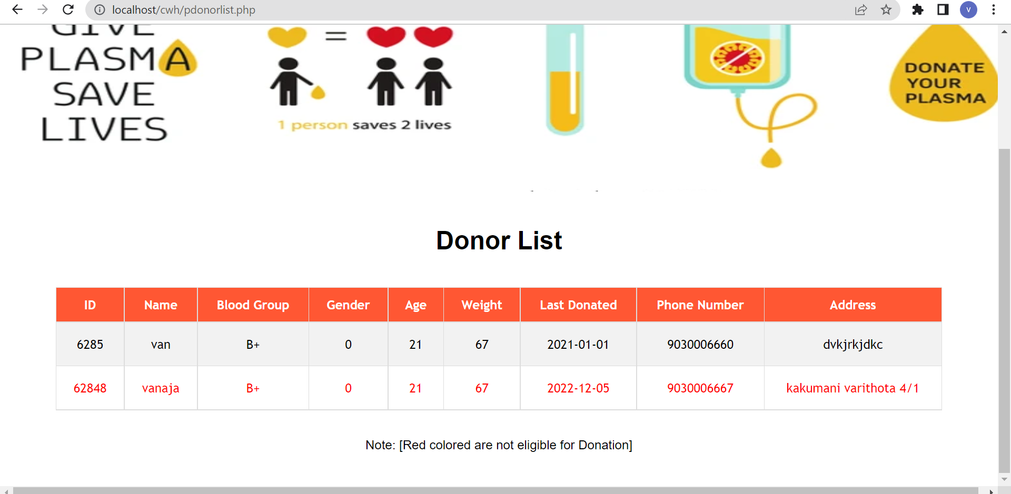

Slide 22
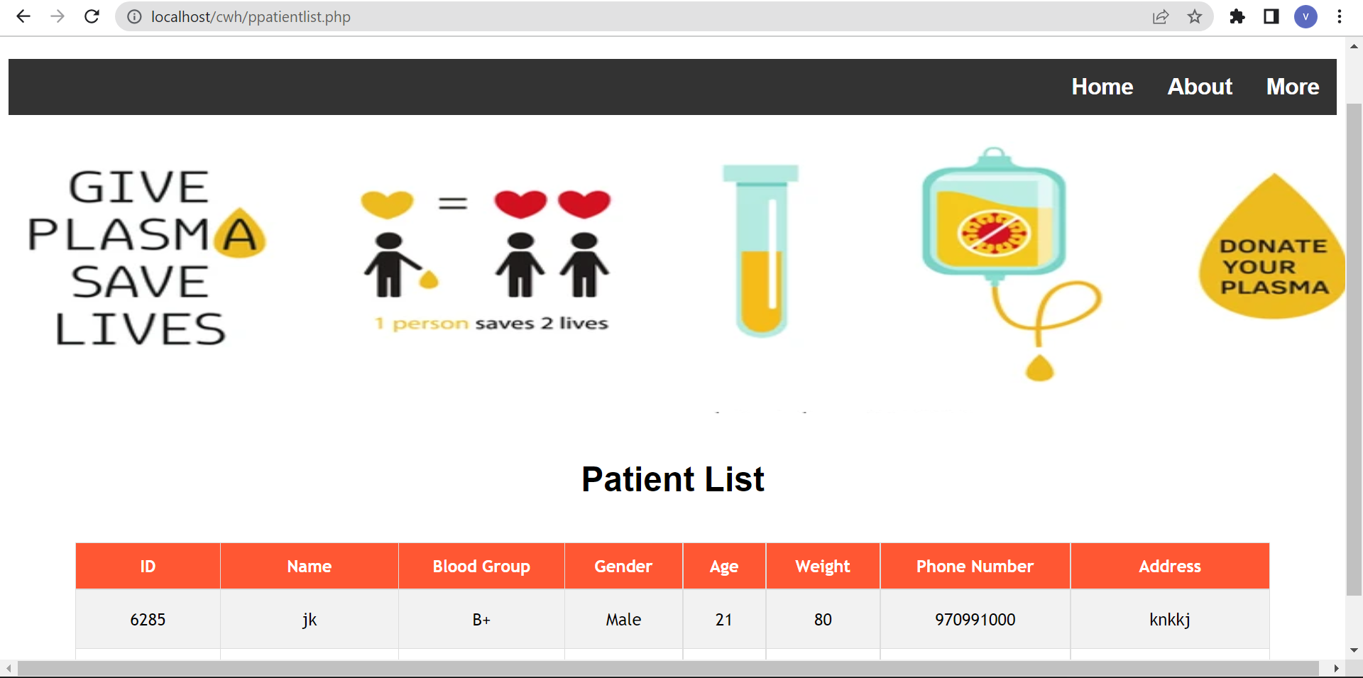

Slide 23
Conclusion:
Our project is only a humble venture to satisfy the needs of a realistic Blood Bank. The objective of software planning is to provide a framework that enables the working of Blood and plasma donation and maintaining all the information pertaining to blood donors, different blood groups available in every Blood Bank and help them manage in a better way..

